Slide 1
Parking Provision in the UK
Quantifying on-street residential parking

Slide 2
Introduction
Aim: to inform Electric Vehicle Charge Point planning of public on-street charge points
Motivation: increase in electric vehicles expected due to Road to Zero emissions commitment by the UK government
Why Data Science: no current existing single data set on parking provision
What data: residential addresses, topography and highways layers, aerial photography, raster data and inferred driveway width
Risks: no ethical concerns, all address data is unassociated from individuals and personal information. Aerial photography data has had any persons removed.

Slide 3
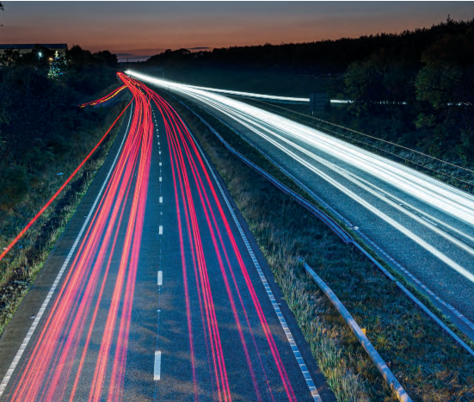


Background & motivation
The Road to Zero by 2050 reducing emissions
future where every vehicle is rechargeable
Electric vehicle chargepoints
range of power ratings: slow/fast/rapid
private / public
ensuring adequate electricity supply
residential parking capacity
off-street parking
adequate on-street parking
inadequate on-street parking
no existing adequate data source
Notes:
UK is committed to reducing carbon emissions by 2050
Essentially preparing to replace the entire UK vehicle stock with rechargeable electric vehicles
These will all need somewhere to charge
since people tend to be home at night it is expected that most charging will take place on or near their property
There will be a mixture of private and public low and high power chargepoints
Where these are and in what proportion will impact the electricity supply
Hence it is vitality important to understand parking availability, from which we can infer Charge Point capacity, and it is expected that properties fall into one of these categories
off-street parking available,
adequate on-street parking – there is enough room for all/most vehicles to park nearby to the property
inadequate on-street parking – there is not enough room
At present there is no definitive data source that quantifies residential parking availability for the UK
Currently there are a few private companies who are trying to sell estimates of off & on-street parking to Local Authorities; using inferior data as they do not have free access to dataset that DfT does under the public sector geospatial agreement
Hence it is important to show that we can provide these estimates to Local Authorities – as it will be free of charge and using better quality data.

Slide 4
Current work at DfT
Off-street parking
project to identify residences using front garden space for driveway
extending to further test areas
planning for running on GCP to scale to UK
Application development
cross government collaboration
Notes:
Off-street parking project
my summer project from last year, before which the team had not approached this problem at all
used Normalized Difference Vegetation Index (NDVI) to identify manmade surface in front garden
and then ascertain if a car could be parked in this space
this work is now being extended to further test areas; eg rural
and including planning to scale up to UK using GCP
this scaling will be applicable to the on-street parking project also
Application development
- there is possibility of a cross government collaboration with cabinet office to make a tool available for Local Authorities, or anyone, to use

Slide 5
Key literature
Emu Analytics
estimate parking based on distance from property building to roadside
limitations and not free
Flynn et al, Swansea University
mapping houses suitable for EV home charging
using CNN deep learning/ transfer learning Google Net
possible licensing issues using Google Street View
Machine Vision
to identify permanent no parking road markings
patten recognition; pedestrian crossing zones
Notes:
Key literature
What have others done on this topic
EMU Analytics and some other private companies have done some analysis
Flynn et al – deep learning CNN. transfer learning using Google Net
machine vision zebra crossings
There are some sub-problems in the data - maybe leave this til after
How to identify road junctions
isoperimetric inequality Osserman, R

Slide 6
Data
Six main data sets
point locations, vector polygons and raster data
attributes
results from off-street parking project
British National Grid coordinate reference system
ethical issues: none
no direct link in data between addresses and people
data is freely available under Public Sector Geospatial Agreement
Notes:
Materials: Data

Slide 7
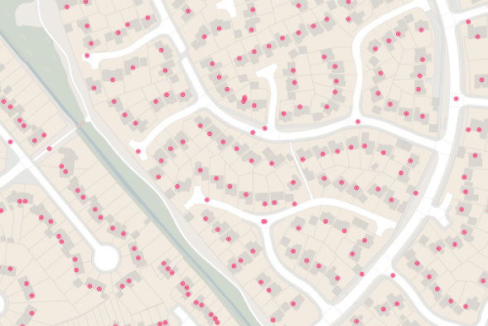
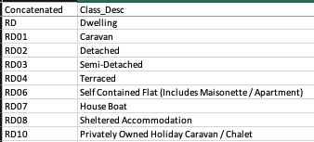
AddressBase Plus
point geometry for every address
four-level property classification scheme
link to TA building TOID
Notes:
Ordinance Survey AddressBase Plus
- point geometry for every address
- four-level property classification scheme
link to TA building TOID
used to identify residential areas
and define radius of reasonable distance to on-street parking

Slide 8
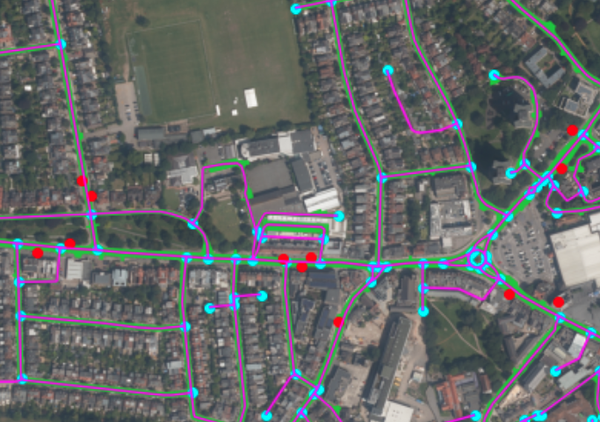
OSMM, APGB & NaPTAN
OSMM Topography layer includes roads and tracks (green)
OSMM Highways layer include road links (magenta) and nodes (cyan)
APGB RGB 25 cm raster layer
NaPTAN bus stop location (red)
Notes:
Ordinance Survey Topography Area layer
- jigsaw of vector polygons
- only intersect on adjacent edges, no overlap
- various descriptive fields
- unique id: TOID per shape
Ordinance Survey Highways Layer
road nodes, road links, and a few others
includes average road width and minimum road width
links are lines so length of road section is easy to calculate
road junctions not specifically designated
Aerial Photography Great Britain
RGB 25 cm resolution images
Organized by BNG 1km square sections
composite image
permanent parking restriction markings are visible
eg zebra crossing, bus lanes
National Public Transport Access Nodes
bus stop point location
some misalignment to roads, can be clipped to nearest road section

Slide 9
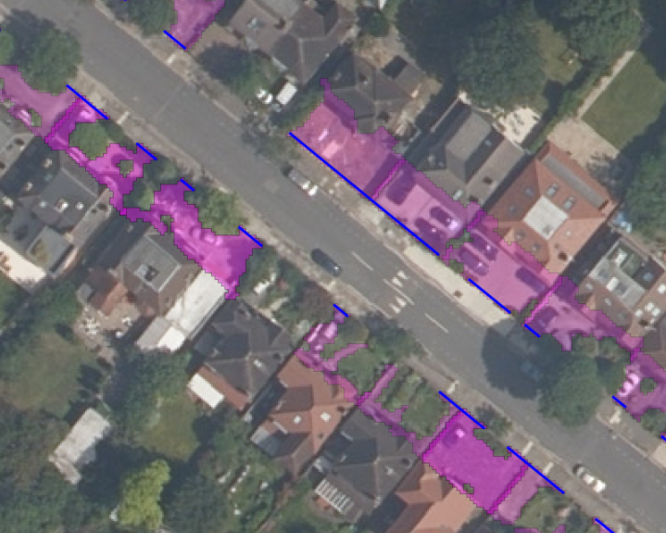
Off-street parking data
Manually labelled residences with off-street parking for test area
Derived driveway width, where boundary intersects with front garden manmade surface area (blue lines)
Notes:
Off-street parking data
This data comes from the results of my previous summer project on off-street parking
For the same test area I manually labelled the residences that appear to have off-street parking, ie a driveway, or large enough manmade surface to fit a car
The driveway width is derived as the intersection between the front garden boundary to the pavement and the manmade surface area which has been calculated using a Normalized Difference Vegetation Index (NDVI).

Slide 10
Data pre-processing
NaPTAN bus stops data is a little inaccurate, will need snapping to nearest road section
Topography layer is filtered to just roads and tracks
Highways layer filtered to road nodes and road links only
Aerial photography and OSMM data is clipped to the 1 km test area, TQ1980 using QGIS and then python (shapely)
Aerial photography further clipped to just the roads, and further transformation depending on machine vision techniques
Notes:
Data pre-processing
NaPTAN bus-stops data has some quirks, some locations are inaccurate by a few metres and not on the road; will need snapping to nearest road section edge
haven’t though how to do this yet
Topography layer of vector polygons is filtered to just roads
Highways layers used are the road nodes (points) and road links (linestrings) these can be filtered by road characteristics (width, type of road etc)
All of the dataset are quite large and need to be roughly clipped to the test area in QGIS a free geospatial software that optimizes handling of large geospatial data
Once roughly clipped these can be handled in memory in python and reduced further
Image data will need further transformation depending on machine vison techniques;
-eg reshaping to 256 by 256 pixels for Google Net deep learning, or feature engineering of descriptors and/or keypoints in edge detection, object (pattern) recognition model.

Slide 11
Methodology
Number of parking spaces = 2 * length of road / length of car
0. 0th estimate is (2 * 14km) / 5m ~ 5700 parking spaces.
eliminate road types; motorways, dual carriageways
include road width to identify double and single parking roads
use isoperimetric quotient or other to identify road junctions and eliminate parking near these areas
remove 5m either side of bus stop locations
remove driveway widths inferred from off-street parking project
use machine vision to identify strict no parking areas from permanent road markings such as zebra crossings, pelican crossings, bus lanes etc
remove remaining isolated sections now too short to park a car in
Notes:
Methodology
The aim is to iteratively improve upon an estimate of on-street parking capacity
Based on the simple formula that the number of parking spaces available is equal to twice the road length divided by the length of a parking space
Starting with this crude estimate and iteratively removing lengths of road determined to be unusable for parking for different reasons
Areas for removal are those where strict no parking applies due to road type, driveway, zebra crossing, road junction etc; that is for physical or safety reasons
Semi-restricted on-street parking areas are not removed as these are within the remit of the local authority to alter permissions and there is no physical or safety reason for no parking.

Slide 12
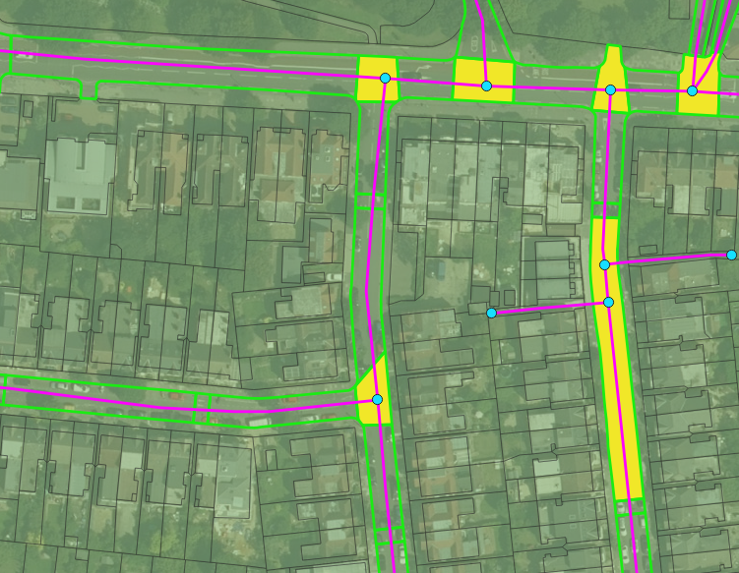
Identifying road junctions
Road sections (green boundary) intersecting with road nodes (cyan point) are usually also road junctions
Not all though; can have a road section with multiple road nodes
And a road link (magenta) may span more than one road section
Notes:
Identifying road junctions
the topography layer cuts road shapes up into sections, and separates things like road furniture, roundabouts and traffic calming (sleeping policeman)
most of the junctions are well defined and intersect with a single road node
some are not though and a road section may include more than one road node (cyan)
also a road link (magenta) may span more than one road section
so I need to work out how to define and remove the areas near the true junctions where parking is strictly not allowed

Slide 13
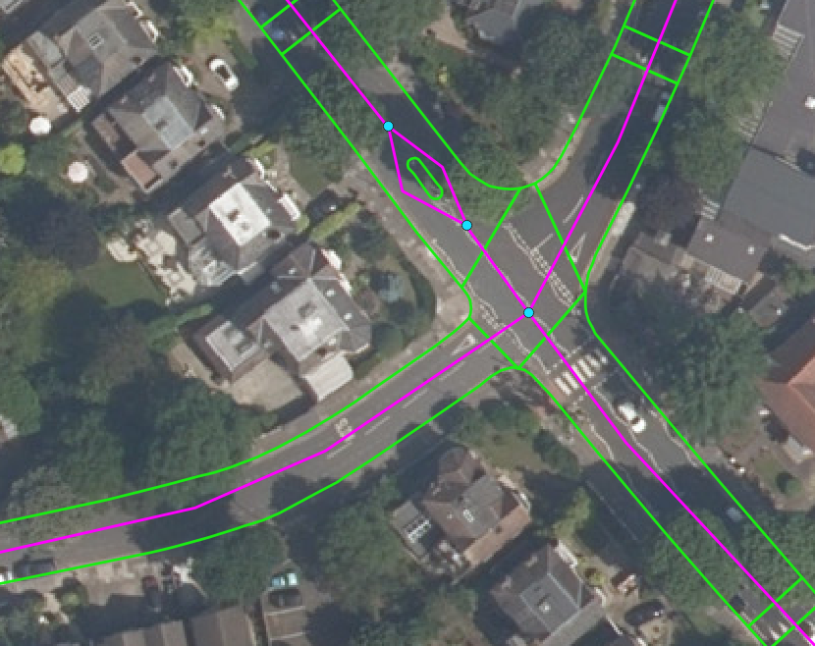
Identifying no parking road markings
zebra crossings
bus lanes
pelican crossings
Notes:
machine vision ideas here...

Slide 14
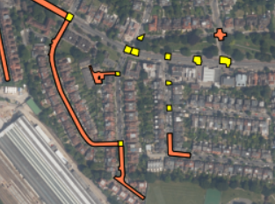
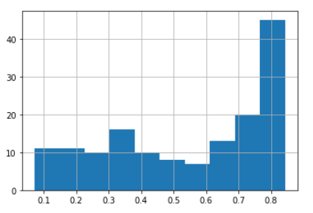
Preliminary results
Established an upper estimate of ~5700 parking spaces
calculated compactness of road sections that intersect with road nodes.
yellow: compactness >= 0.6
coral: compactness < 0.6
some junctions are missed
improve by calculating compactness based on smallest bounding convex shape
Histogram of compactness
Notes:
As mentioned I’ve established an upper estimate of ~5700 parking spaces; assuming parking is possible on both sides of the road and the full length of the road links
I completed some tests using the isoperimetric quotient to measure compactness of a shape to identify road junctions
this plot shows this road sections coloured by compactness; yellow is 0.6 or greater and coral is less than 0.6.
you can see that some road junctions are missed; this cross roads, because it includes bits of the four roads makes the shape more concave and hence less compact
to improve this split I can calculate compactness based on the smallest bounding convex shape, or introduce other information like
comparing road width to shape perimeter.

Slide 15
Expected results
expect to iteratively improve upon an estimate for on-street parking
visually show on-street parking spaces
manually validated by visual inspection of the 1 km square grid
each stage in the iteration can also be independently validated
driveway widths
zebra crossing locations
Notes:
May have to broaden the test area for different stages; for example, there aren’t that many zebra crossings in this area

Slide 16
Roadmap & timeline
What are the next tasks?
to finish the filtering stages based on named features in the data
continue with experiments for identification of road junctions
to begin machine vision section
When are these tasks expected to be completed?
aim to start machine vision within one week
Are there any risks that could prevent these tasks from being executed?
underestimate of the task complexity
Notes:
What are the next tasks?
What questions will they answer?
When are these tasks expected to be completed?
Are there any risks that could prevent these tasks from being executed?
to manage these risks I have:
asked a colleague at work from the data science team to have a weekly catch up with me to act as a sounding board for ideas and sense checker
reconnected with a colleague at Ordinance Survey who has expert knowledge of the datasets; and is familiar with the project I did on off-street parking last year
need to to organise a catch up with Sarah Rowlands to get her opinion on my approach to the machine vision task

Slide 17
Conclusions
aim is to inform electric vehicle charge point planning by quantifying on-street parking availability in residential areas
divide the length of road available for parking by the length of a standard parking space
iteratively improve upon this estimate by removing different types of no-parking areas as identified in the dataset and using machine vision
provide local authorities with information required to plan for electric vehicle uptake free of charge and using a standardized methodology

Slide 18
Thank you for listening!
Questions?

